Slide 1

B.Tech External Project Evaluation, VIIIth Sem
I (Smart Stick for Visually Impaired)
Presented by :-
Shruti Khatri, 2019619241
Yashpal Besoya, 2019560320
Vaibhav Yadav, 2019636177
Under the Supervision of:-
Dr. Sudeep Varshney
Assistant Professor, SET, Sharda University, Gr. Noida
DEPARTMENT OF COMPUTER SCIENCE & ENGINEERING
SCHOOL OF ENGINEERING AND TECHNOLOGY
1

Slide 2
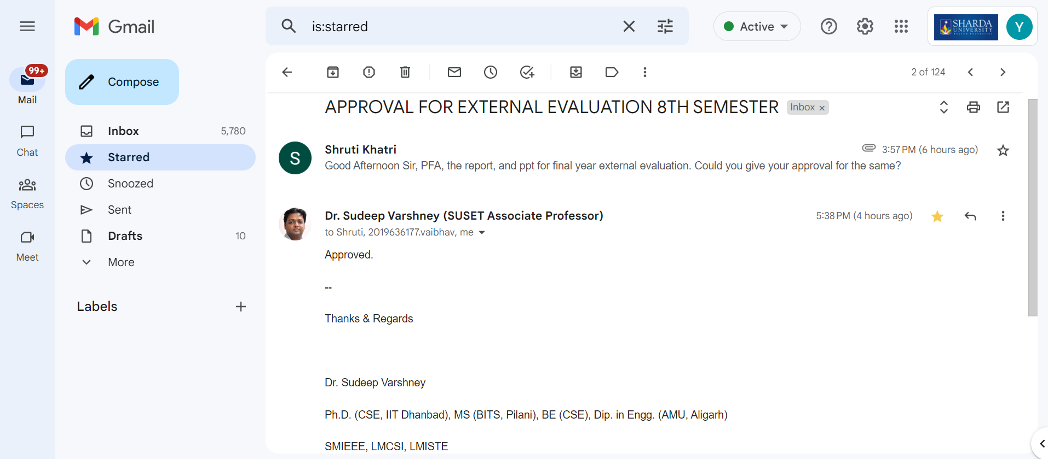
Approval from guide for the Evaluation

Slide 3
Contents:
Introduction
Problem Statement
Functionalities
How “I” is helping the target Community?
Results
Future Scope

Slide 4
Introduction
The visual organ, the eye, is a vital part of human physiology due to its aptness of receiving and transmitting perceptible details to the brain. There is a saying that to be blind is not miserable; not to be able to bear blindness, is miserable.
In addition, the 83% of the environment’s knowledge reaches us through the eyes, which plays an important role in people's lives. But there is quite a large number of people who are not fortunate enough to let that knowledge slide in through their eyes.
There are various hurdles in the lives of visually impaired people which compel them to ask for assistance. This makes them feel weak and less confident about themselves.
The major problem that visually impaired people face is mobility. Traditionally, blind people have been using ordinary mobility cane sticks to move around by poking the hurdles or obstacles to find their way. This traditional aspect caused a lot of trouble for them as well as for the passing by people.
In this contemporary world, we decided to make use of the technology available to provide some comfort and succor to these disabled people. So, to feel “Normal” about being blind or visually impaired, this smart stick has been introduced named “I” (pronounced as “eye”).
When you have a friend that is just like you or if you only become your own friend, life becomes much easier as you won’t feel dependent on somebody, rather it would be you only on whom you are dependent.

Slide 5
Problem Statement
The goal of this proposed model is to create a solution which will not only assist the visually impaired community but also make them feel more confident in the way they live.
The major problem that visually impaired people face is, mobility and to overcome this problem, “I” has been introduced.
To roam the surroundings/areas as if you have your own working eyes, is a blessing that this proposed system will provide. It will detect the solid obstacles with the help of ultrasonic sensors, liquid obstacles with the help of water sensors, dark/dim light area with LDR module and in case of emergency the GPS and GSM module comes to action.
Additionally, existing smart stick solutions on the market are often prohibitively expensive and inaccessible to individuals from lower socio-economic backgrounds. Therefore, there is a pressing need for an affordable and effective smart stick solution that provides real-time feedback on obstacles and terrain, improves navigation and orientation, and enhances the overall independence and quality of life of visually impaired individuals.
The present product is cost-effective and can be afforded by any class. Also, the usability is not complex and can be operated easily.

Slide 6
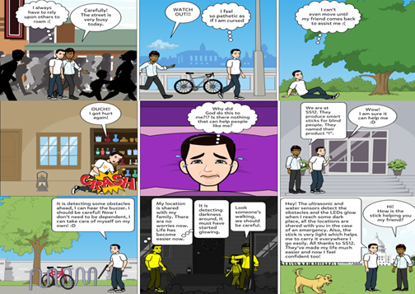
Fig.1 Depiction of Problem Statement

Slide 7
Functionalities of “I”
1. Ultrasonic Sensors
Ultrasonic Sensors would detect the solid obstacles in the way of the user.
2. Water Sensors
Water Sensors would detect the damp or wet hurdles in the path of the person who is using the proposed system. It would help the person to dodge the dump or potholes that are filled with liquid.
3. GPS and GSM Module
Global Positioning System is used in the stick to provide the real-time location of the person using the proposed system to their family members and loved ones so that they can keep track of the person and offer help in case of an emergency. The location can be sent to the acquaintance’s registered sim with the help of the GSM module.
4. LDR Module and LEDs
Light dependant Resistor works in dark or dim-light surroundings and triggers the LEDs so that the passing by entities can see the user in the same environment and accidents can be avoided.

Slide 8
How “I” is helping the target community?
The hard obstacles will be detected with the help of Ultrasonic sensors, the user can easily be notified with the help of a buzzer to dodge the obstacle.
The damp area or wet hurdles will be detected using water sensors and the user will be alerted by the buzzer.
If a person reaches an area where there is either dim or no light, the stick would immediately start glowing which is implemented using the LDR module and the glow would come from the LED light used. This will help the passerby easily identify the user in the dark and avoid accidents.
Also, there is an integrated GPS system that may be used in case of an emergency to send the real-time location of the user to his/her close acquaintances. And to deliver the message on the mobile phone of the acquaintance, a GSM module is used. This would help the user in case of an emergency and otherwise keep the family and close acquaintance feel relaxed when the user moves out of the house.
All the major hurdles related to mobility are solved using this simple-to-use stick.
The user feels independent, he/she gains confidence back, and starts to feel like a normal person despite having a disability to see.
The cost of developing this prototype used is minimal and affordable.

Slide 9
Results
To evaluate the performance of the proposed product for visually impaired individuals, we conducted a user study with 30 participants out of which one is shown below in Fig 2. The objectives of the study were to measure the accuracy of obstacle detection, the speed of obstacle detection, and the usability of the device.
We used a combination of quantitative and qualitative methods to collect data, including surveys, interviews, and observation. The main metrics that we used to evaluate performance were accuracy, speed, and user satisfaction.
Our results showed that the smart stick was highly accurate in detecting obstacles, with an average accuracy rate of 94.33%. It was also fast, with an average detection time of 0.5 seconds. Users reported high levels of satisfaction with the device, rating it an average of 8 out of 10 on a usability scale.
Overall, our performance estimation suggests that the smart stick is a highly effective and user-friendly device for visually impaired individuals. However, it should be noted that our study was limited to a relatively small sample size and may not be generalizable to other populations. Future research could explore the performance of the smart stick in different environments and with different user groups."

Slide 10
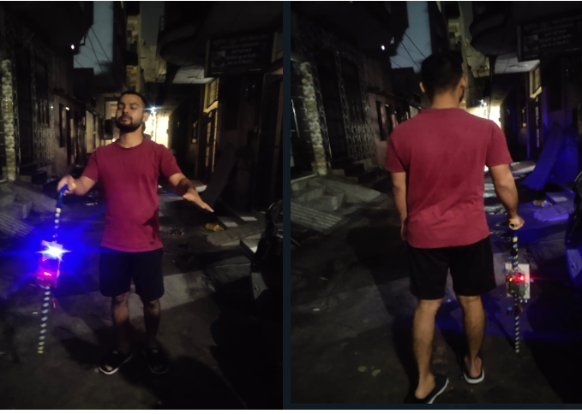
Fig.2 Survey for the accuracy of the proposed model

Slide 11
Future Scope
The smart stick for visually impaired individuals has a wide range of potential future applications and scope. Here are some potential areas of development and innovation:
Integration of Artificial Intelligence (AI): The use of AI can enable smart sticks to learn and adapt to the user's needs and environment, leading to more accurate and personalized assistance.
Advanced Sensors: Future smart sticks can be equipped with advanced sensors, such as lidar or radar, to provide greater environmental awareness and more detailed information about the user's surroundings.
Connectivity and Interoperability: Smart sticks can be designed to be compatible with other devices and systems, such as smartphones or smart homes, to enhance communication and accessibility.
Enhanced Navigation and Guidance: Future smart sticks can incorporate more advanced navigation and guidance features, such as voice-based turn-by-turn directions, pathfinding, and real-time obstacle detection.

Slide 12
Multimodal Interaction: The integration of multiple modes of interaction, such as voice commands, and haptic feedback, can improve usability and accessibility for visually impaired individuals.
Assistive Technologies: Smart sticks can be integrated with other assistive technologies, such as braille displays or hearing aids, to provide a more comprehensive and inclusive experience for visually impaired individuals.
Overall, the future scope of smart sticks for visually impaired individuals is vast, and with continued research and development, it has the potential to greatly enhance the lives and independence of visually impaired individuals.

Slide 13
Thankyou

